Slide 1


Adidas Sales Dashboard
Insights

Slide 2
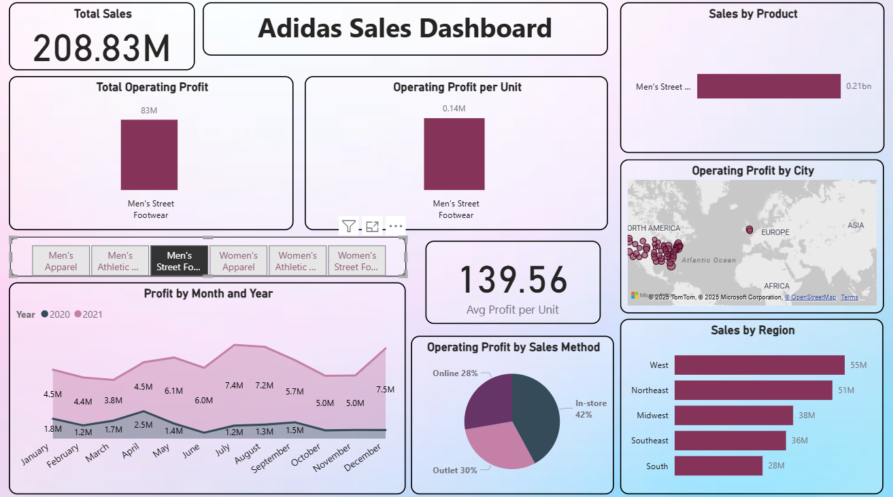
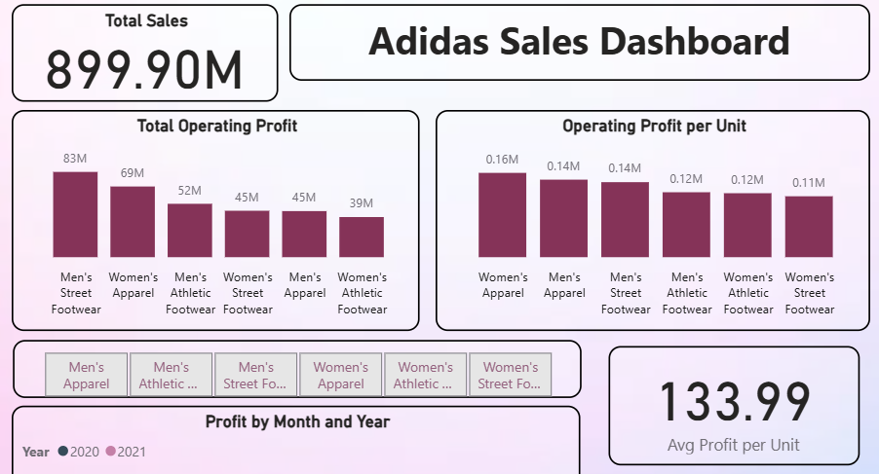
EXECUTIVE SUMMARY
Total Sales: 899.90M
Average Profit per Unit: 133.99
Top Performing Category: Men’s Street Footwear (highest total operating profit).
Most Profitable per Unit: Women’s Apparel (0.16M per unit).
Decision Insight: Strong revenue, but product profitability varies widely — focus on high-margin items to improve overall profitability.

Slide 3
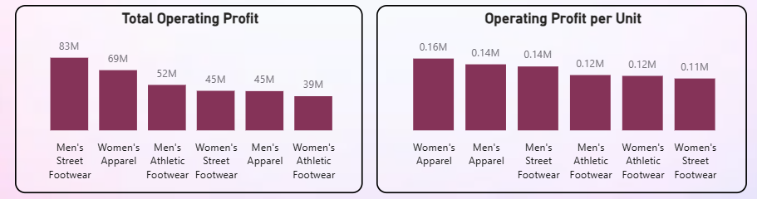
SALES & PROFIT PERFORMANCE
By Category:
Men’s Street Footwear leads in revenue and operating profit.
Women’s Apparel leads in profit per unit (high-margin).
By Region:
West region dominates sales (0.27B).
Midwest & South lag behind — potential for growth campaigns.
Decision Insight: Consider reallocating marketing budget to underperforming regions and expanding high-margin product lines.

Slide 4
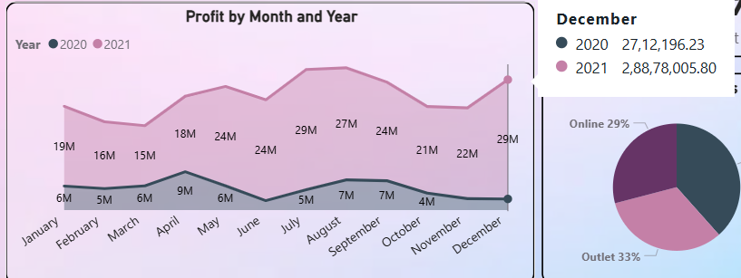
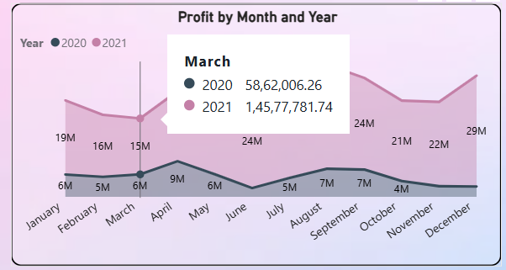
SEASONAL TRENDS
Profit Peaks: May, August, and December.
Lowest Months: February, March.
Decision Insight: Run promotions or product launches in low-performing months; stock up for peak periods to maximize sales.

Slide 5
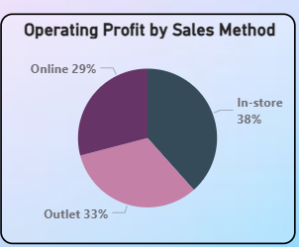
CHANNEL PERFORMANCE
Operating Profit by Sales Method:
In-store: 38%
Outlet: 33%
Online: 29%
Decision Insight: Strengthen online marketing & customer experience — online still has untapped potential compared to in-store.

Slide 6
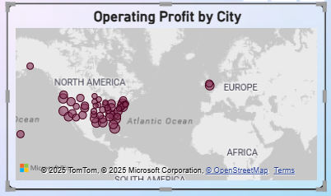
GEOGRAPHIC INSIGHTS
North America & parts of Europe have dense profit clusters.
Certain markets show less coverage — may indicate untapped areas.
Decision Insight: Explore partnerships or retail expansion in underrepresented geographies.

Slide 7
ACTION PLAN
Short Term: Boost online presence, optimize inventory for seasonal spikes.
Mid Term: Focus on high-margin categories, expand in low-sales regions.
Long Term: Data-driven product portfolio realignment based on profitability per unit.

